Slide 1

Cable Effects Study Program Review and Cable Modelling Approach
Douglas Coombs
May 2, 2011
Notes:
1

Slide 2
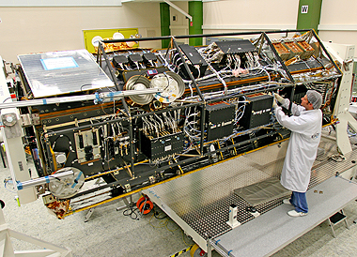
The Cable Effects Study Missions
Do electrical cable harnesses significantly affect dynamics of precision spacecraft structures?
Lightweight and with stringent jitter budgets
Cable harnesses are generally not included in spacecraft structural design. As a consequence:
Models and designs are overly conservative
Isolation system requirements are too stringent
Structural control systems may be adversely affected by plant model errors
Motivation: develop techniques and methodologies to incorporate cable dynamics in models thereby reducing conservatism and program risk
Cabling makes a significant amount of dry mass
http://www.dlr.de/rd/en/Portaldata/1/Resources/portal_news/newsarchiv2009_3/Tandem-X_intergration_380.jpg
Notes:
Answer question: Do electrical cables significantly affect structural dynamics of precision spacecraft?
Status Quo: cable harnesses dynamics unknown and not included in models
Results of this: 1) models overly conservative, 2) isolation system requirements too stringent, 3) control systems have errors and are overly designed.
Motivation: Develop techniques and methodologies to incorporate cable dynamics into models in order to reduce conservatism and program risk.

Slide 3
The Why of the Cable Effects Study
Cable harnesses are a large part of spacecraft mass and generally considered a non-structural component at low frequencies.
A survey showed that the cable-to-structure mass ratio for DoD and commercial spacecraft can approach 25%.
Cables are not modeled in detail because no one cared about the “mid frequency” range until a need for better large precision structure models was identified.
Mission performance is driven by on-orbit dynamics: better models are required.
The program was directed to finding a solution to an Air Force need, not to develop an understanding of the fundamental mechanics of cable behavior.
Applied research
Notes:
Why:
Cables a large part of spacecraft mass: up to 25%
Cables not modeled in detail because the need is an emergent one: on-orbit performance of lightweight, precision spacecraft where they play a significant role in the dynamics – a “mid frequency” range problem
Program was directed to finding a solution to a perceived need, not to develop and understanding of the fundamental mechanics of cable behavior.

Slide 4

The Significance of Cable Modelling
Electrical cables mounted on space structures can influence the structural dynamics.
The effects of cables on spacecraft dynamics is not documented in the industry.
Cables not included in models can impact controller performance and robustness, impact isolation system requirements and increase program risk.
Model errors are determined late in the flight program (i.e., when cables exist). Is there time for controller tuning? The worst time to determine that the controller is miss-tuned is when the satellite is on-station.
Notes:
Significance:
Cables can significantly influece structural dynamics of a system
Model errors currently determined late in the program (after the structure is built). Worst time to figure this out. Time and money may have been spent fighting a non-existent problem (mode is now damped). Controller may need to be re-tuned when on station.

Slide 5

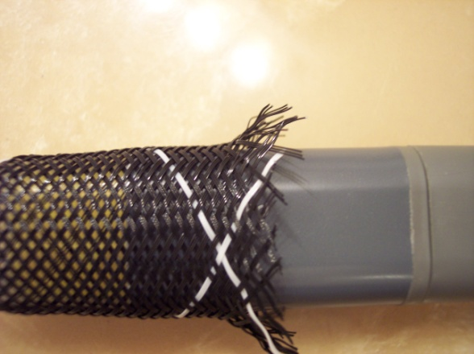
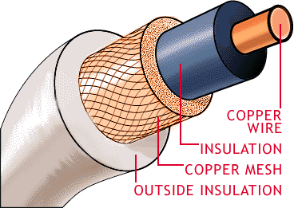
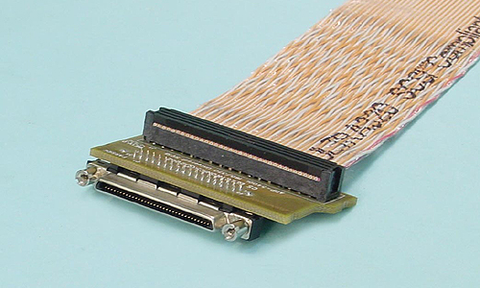

The What of the Cable Effects Study / Focus Restrictions
Only studied small-to-moderate conductor count twisted pair cable bundles.
Not coaxial, ribbon cables, twisted pair in wire or polymer braided sleeving.
Concerned with low-level vibration problem (i.e., when the spacecraft is on-station), not launch vibration or shock conditions.
Cables with bends and connectors excluded from study.
Notes:
Focus limited to
-small to moderate count twisted pair cable bundles
-no bends or connectors
-low level vibration problem (on-orbit excitation), not launch conditions

Slide 6
The How of the Cable Effects Study
Cable models are implemented using Nastran standard elements.
Well integrated with standard analysis tools
Linear beam elements are appropriate, using composite properties and general formulation.
Measurements showed that cable models must include shear: a Bernoulli-Euler beam formulation cannot predict cable dynamics
Equivalent cable properties in the Nastran deck are obtained through experiment and parameter estimation
The cable-to-structure model uses linear spring elements (PBUSH)
Spring properties were identified through experiment
Validation experiments used throughout the program for cable parameter estimation and modeling techniques
Demonstration experiment to verify methods
Validation and verification – it was a research program
Notes:
- Cable models implemented with standard FE tools (NASTRAN in particular used for program)
Linear beam elements used with generalized formulation and independent beam properties
Simple rigid and linear spring elements used for cable-to-structure attachment
Validation experiments used to verify experimentally determined parameters.

Slide 7
Research Topics not Included in the Cable Effects Study
Bundles of twisted pair conductors exceeding 30 pairs and 20 AWG
Limited design space to maintain focus
Nonlinear cable models
Parameter extraction was based on the assumption of linear behavior
Detailed cable mechanics
Model-based cable bulk property derivation
Cable loss mechanism models
Inter-strand in a conductor, loss due to strain energy in the conductor shields or conductor-to-conductor loss
Localized cable tie-down behavior
Notes:
We did not study
Large cables
Nonlinear cable models
Detailed cable mechanics (a bit of a holy grail to avoid the testing phase for cable property derivation)
Localized cable tie-down behavior.

Slide 8
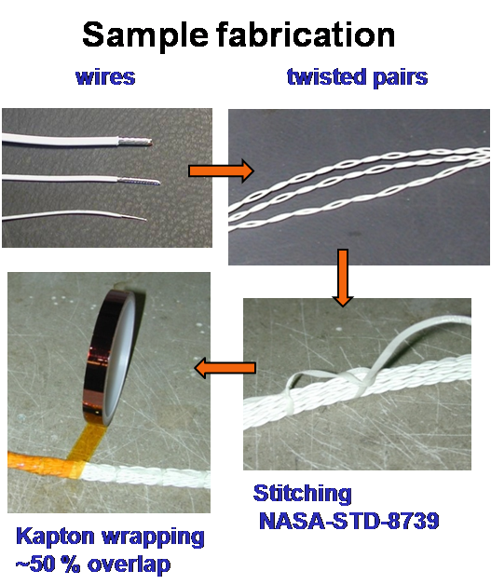
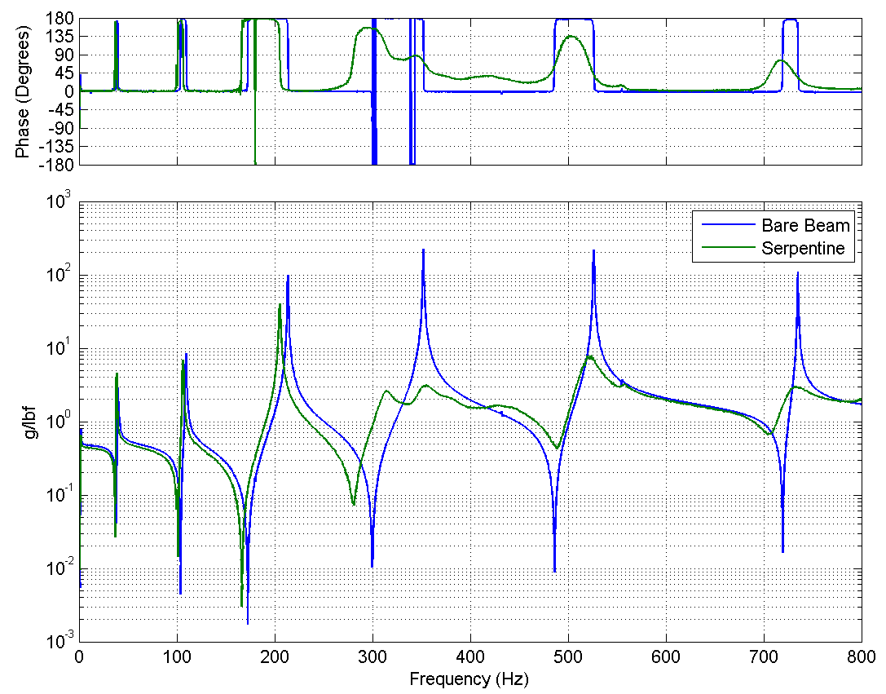
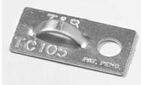
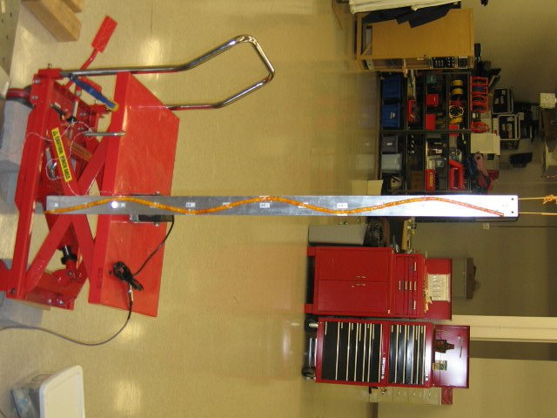
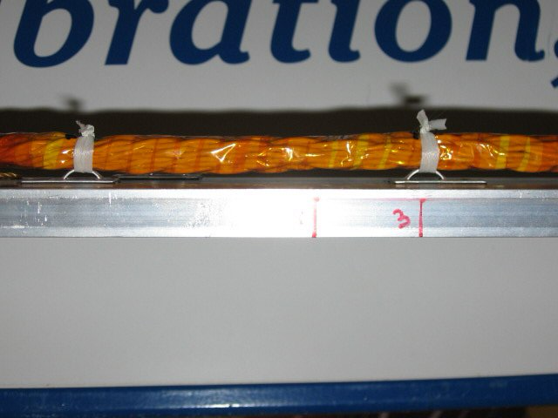
Cable Construction and Effects on Dynamics
Bundles of twisted pair single-conductor wires stitched and wrapped with Kapton® tape
Consistent with spacecraft power and signal cable fabrication
Cables add damping and can shift modal frequencies
Cable not resonant
Cable resonant
Notes:
Cables constructed of
Silver coated copper wires with teflon insulation
Twised in pairs
Loosely stitched together to hold them while
Wrapping in Kapton tape
Commonly used cable type from industry survey.
Overview of results
Cables can influence structural dynamics
Below resonance, no dynamic effects, just slight shifting due to mass and static stiffness
Above cable resonance, significant damping added to modes. TMD effect may be seen depending on “tuning” of cable mode to structural modes.

Slide 9

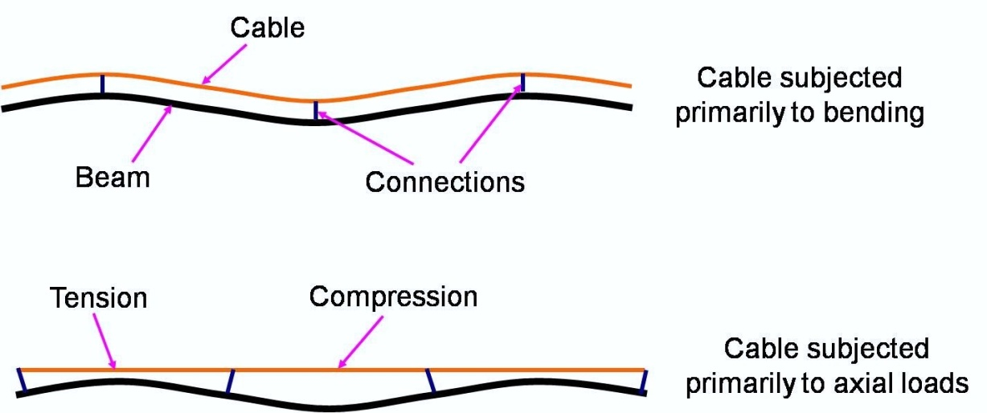
Attachment to Host Structure: Cable-Structure Interaction
Cable attachment to host structure
TC-105 mounting tabs bonded to host structure
Allow controllable cable attachment using zip-ties and installation tool (zip-tie gun)
Lacing cord used as an alternative to zip-ties
TC-105
Lacing cord
Cable-structure interaction
Cable
Base Structure
Notes:
Cable attached with a mounting pad (e.g., Clickbond or TC105) and lacing cord or zip tie
Need to know both E and G

Slide 10
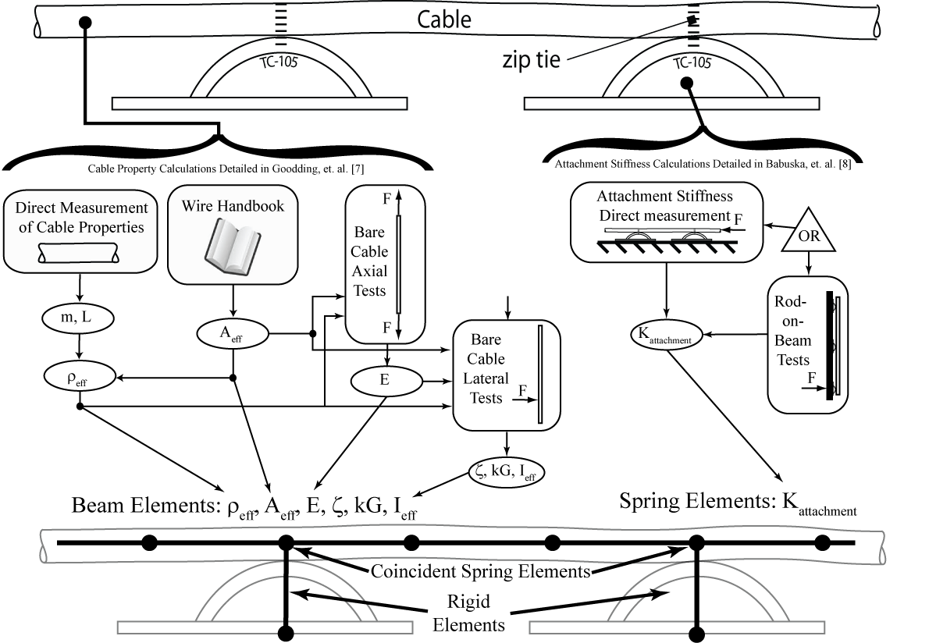
Cable Modeling Approach Overview
Notes:
How to go from cable structure to FE model
Cable modeled as Shear beam elements (Timoshenko beam neglecting rotational inertia)
Get basic info like cable mass and copper area from wire handbook and direct measurement
That feeds into axial tests from which extensional modulus is determined
All that feeds into lateral tests from which damping, effective moment of inertia and shear modulus are determined
Mounting pad and zip tie modeled as rigid element and coincident node spring element
Stiffnesses determined from direct measurement dynamic experiments or rod-on-beam tests
Alternate Slide Description
Cables modeled as linear shear beam elements
Properties determined from a combination of handbook and experiments
Tie-down and zip ties modeled with a rigid element and coincident spring elements
Properties determined from 1 of 2 dynamic experiments

Slide 11
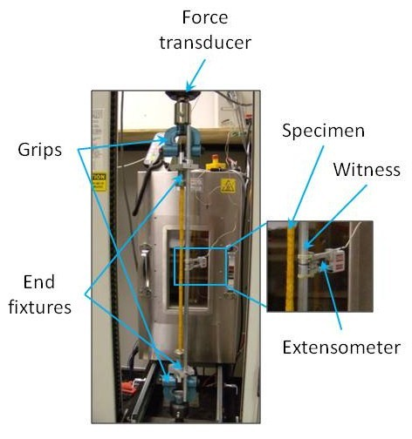
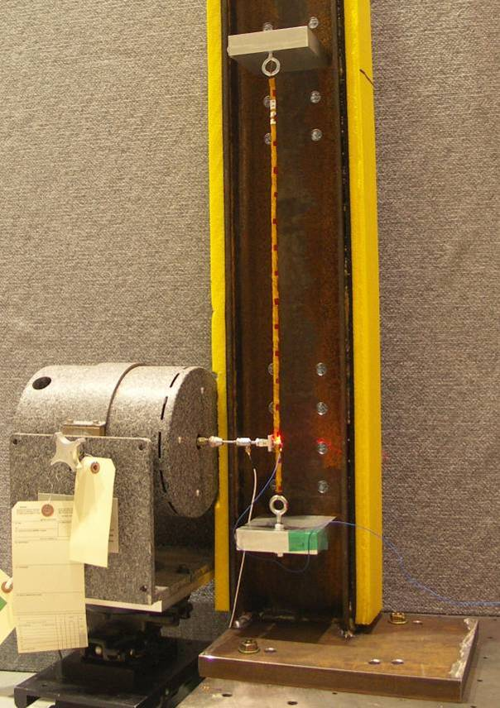
The Cable Parameter Extraction Mission and Approach
Test-derived cable properties are needed
What is the appropriate model for a cable?
Inputs for linear finite element models
Extensional modulus derived through test
Shear modulus based on lateral driving point mobility FRFs
“Easy” to measure
Challenges
Account for vibrometer time delay
Cancel driving point fixture mass loading effect
Repeated roots
Lightly damped fixture modes
Parameter estimation algorithm
Based on a beam model including shear
Specimen cross sectional area and extensional modulus from tensile tests
Determine area moment of inertia and k’G
Validated through experiment
Notes:
How were the cable properties extracted?
Need to determine the appropriate model (BE, Timoshenko, Rayleigh, Shear beam)
Extensional modulus derived through static tension test
Shear modulus, damping, moment of inertia through lateral dynamic test using driving point FRFs
Easy type dynamic test, if testing a noodle is ever easy.

Slide 12
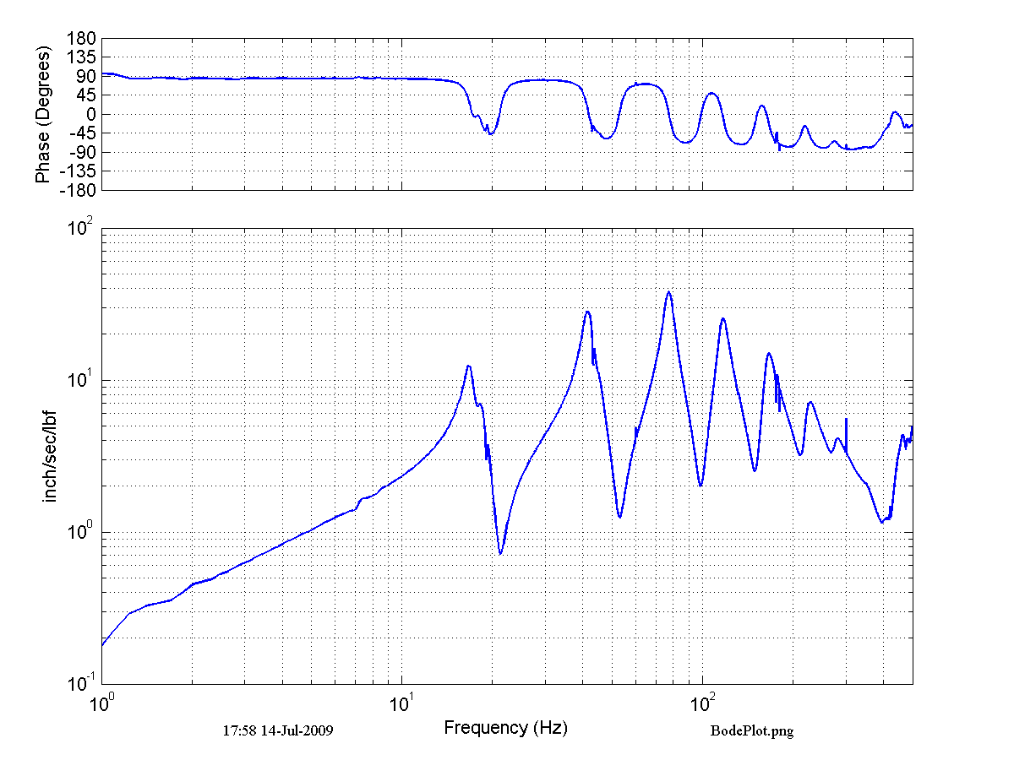
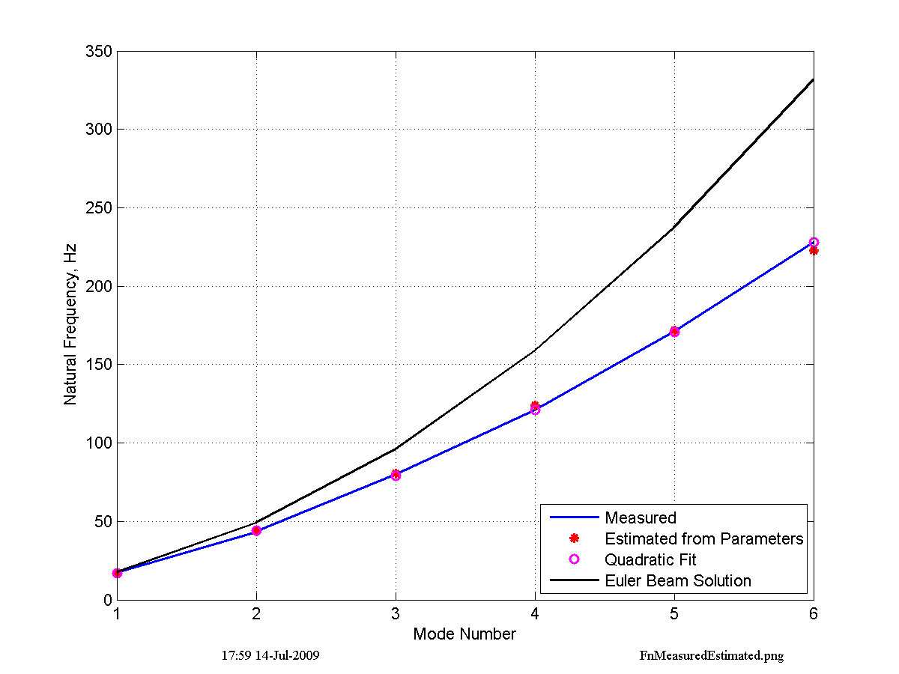
Cable Natural Frequency Progression: The Beam Model Indicator
The natural frequency-to-mode number progression of a cable follows a quadratic relationship
This is how an beam behaves
Diverges from elementary beam theory: shear must be included
Notes:
Both shear and BE modal progression is quadratic, but the BE coefficient is incorrect.

Slide 13
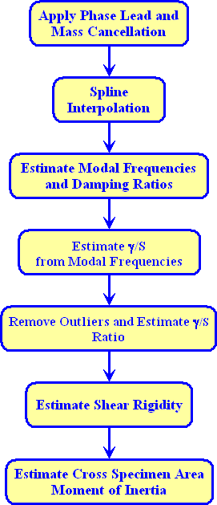
Bare Cable Lateral Test: Parameter Estimation Approach
Measurements are cleaned up
Modal parameter estimation step
γ ( ) and k´G determined from modal frequencies
Estimate I and effective diameter
Damping averaged over all modes
Estimated parameters benchmarked by comparing shear model frequencies and measurement
Parameters estimated for different spans of each cable specimen and multiple specimens of each cable construction
Notes:
Taking lateral test data from the previous slide…
Modal parameters Ieff, kG and damping are extracted
Numerous cables of a given size tested to compile statistically significant family for averaging

Slide 14
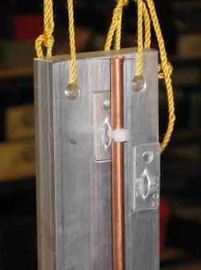
Parameter Estimation: Tie down stiffness
Rod-on-beam eliminates cable property uncertainty
Tune attachment stiffness to correlate test and model FRFs
Direct measurement tests an alternative means to estimate
Assumes cable is infinitely stiff over frequency range of estimate
Copper Rod
Notes:
Estimating tie down stiffness
Two test methods developed.
Rod-on-beam eliminates cable property uncertainty
Direct emasurement of stubby (stiff) cable in-situ on rigid base

Slide 15
Model Validation: Tie downs
Tie-down parameters play an important role in cable/structure interactions
Offset more important for stiff cables than for compliant ones
Rod-on-beam based attachment stiffness values used in cable-on-beam models
Stiffnesses from “direct measurement” tests did not perform as well
From rod-on-beam correlation:
K₁=K₂=K₃ = 3x10⁴ lbf/inch
K₅ =K₆ = 100 inch-lbf/rad
Notes:
Found that
tie-down parameters do play important role in cable/structure interaction
Offset was more important for stiff cables than complian ones
Rod-on-beam based stiffness values worked better in cable on structure models
Both performed better than simple pinned-pinned connection.

Slide 16
Cable-on-Beam Results
Cable not resonant
Cable effects differ over two distinct frequency ranges
Mass and stiffness effects below cable resonance
Increased damping above cable resonance
Good agreement between measured and modeled dynamics
Build-to-build variability is evident in predictions using “coupon” or “family” cable properties
Cable resonant
Notes:
Two different types of cable effects
Low frequency, before the cables become resonant = small mass and stiffness effects, nearly negligible
After cables become resonant, they begin interacting with structure
Two FRFs from cable models shown on plot. The magenta = very close agreement, properties derived from cable that was tested
black dashed line, properties derived by average cables of the same size. It captures overall effect, but has considerable error compared to cable specific model.

Slide 17
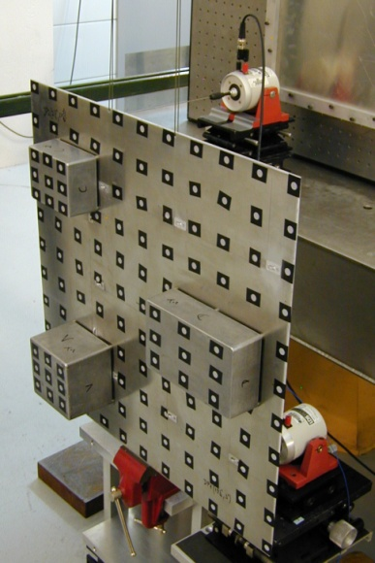
Model Validation Effort – A Panel Structure
Mission: A test case to prove the applicability of the cable test, parameter estimation and modelling methods to a spacecraft-like panel
Ground rules: Conduct experiments to quantify dynamics. Modelling effort uses estimated cable properties, but cannot include model tuning.
Test case
Aluminum panel 2’ x 2’ x 3/16”
Three cast aluminum electronics boxes
Cable mass ratios ~ 3% or 6%
Notes:
Cabled Panel testing extended the 1-D beam testing to a 2-D structure
Electronics boxes were attached to make it more like a spacecraft panel
This was a validation test, and results were not used to refine cable or attachment parameters
Of note, cable mass ratios tested were between 3 and 6%, very much on the low end of what one would expect on an actual spacecraft panel.

Slide 18
Measured Driving Point FRFs
Little influence in panel dynamics below cable resonance
Various cable spans become resonant between ~75 and ~175 Hz
Determined by cable type and open span dimensions
Low cable-to-panel mass ratio limits the cable influence on the coupled dynamics
Notes:
Here are FRFs from the 3 types of cables tested on the panel.
Various cable spans become resonant over this frequency range (75-175 Hz)
Below 75-100 Hz, no damping seed from cables. Lumped mass models are sufficient.
From 75-175 Hz, the cable interaction and added damping become more evident.
Above 175 Hz, cabled panel FRFs are very distinct from the uncabled panel FRF
The greatest damping is evident in the 20-20 cable, which was about twice the size of the other cables.

Slide 19
Panel Model Validation
Compared traditional modelling approach (i.e., nonstructural mass) with dynamic cable models
Running RMS metric is driven by modal damping
Lumped mass approach does not account for coupling and over estimates response
Nonstructural mass approach may be adequate for low frequencies and low cable/structure mass ratios
Least benefit from dynamic cable models with low mass ratio and/or large magnitude non-interacting modes
Running RMS error, zeroed at 90 and 200 Hz
Notes:
Looking at the 26 gauge, 30 twisted pair (3% mass fraction) cabled panel
* Cable dynamic models capture the onset of cable effects (130 Hz) very nicely
* They capture the increased damping (over an order of magnitude FRF peak decrease) much where the lumped mass model fails to do this.
The running RMS error shows this increased ability of the model to capture the system energy.
*RMS error zeroed at 90 and 200 Hz so that large magnitude low frequency modes don’t drown out the lower magnitude modes (also, running RMS calculation is non-linear and minimizes higher frequency results relative to low frequency results).
*Purpose of second FRF is simply to show limitations of cable modeling benefits (112 Hz large magnitude pole with little cable effect, 175 Hz lower magnitude pole with significant damping due to cables)
*least benefit from dynamic cable models with low mass ratio and/or large magnitude non-interacting modes in frequency range of interest.

Slide 20
Shear Modulus Choice
Use of “family” or “coupon” shear modulus values does not have large impact on model accuracy for cables tested
Different conclusion than for cable-on-beam test

Slide 21
Major Findings
A shear beam model predicts cable dynamics
Coupon tests may be justified for critical applications
Variability in cable properties can be traced to
Cable construction due to hand fabrication
Differences in wire structural properties can vary between lots
Running stitch tension
There is evidence of cable property dependence on span
Measurement of cable extensional modulus requires a low load capacity tensile test machine and a custom extensometer witness fixture
Rod-on-beam validation experiments were instrumental in refining connection stiffness value estimates

Slide 22
Summary
Innovative test, analysis and modelling approaches were developed to
Increase accuracy of models to include the influence of power and signal cables
Used standard linear finite element model methods
Cables can have a significant impact on coupled structure dynamics
Mass loading on the cable stiffness line
Increased damping above first cable resonance
Large reductions in resonant response when cable and host structure natural frequencies are close to one another
The traditional nonstructural mass approach cannot predict the cable interaction, leading to overestimates of resonant response

Slide 23
Open Research Topics
Develop cable fabrication techniques to increase cable predictability for structural dynamics
Extend efforts to include other cable construction methods
Considerable interest in the space community
Extend efforts to more massive cables and those with bends and connectors
Cable service loop modelling
Study behavior of cables under launch vibration and mechanical shock conditions
Workmanship under high loading conditions
Mounting bracket strength
Concerns in the space industry and DoD
Detailed cable mechanics
Reduce dependence on empirically derived properties
Accelerate modelling and analysis programs

Slide 24
Questions

Slide 25
Acknowledgments
Thanks to the Air Force Research Laboratory and the Air Force Office for Scientific Research for funding.
Thanks to the following project collaborators without whom this work would not have been possible.
Dr. Vit Babuška - Sandia National Laboratories
Dr. Emil Ardelean - Schafer Corporation
James Goodding - CSA Engineering
Cody Griffee - CSA Engineering
Greg Mehle - CSA Engineering
Dr. Lawrence “Robbie” Robertson AFRL, SV*
Dr. Steve Lane - AFRL, SV*
Brea Ingram- AFRL, SV*
*AFRL, SV = Air Force Research Laboratory, Space Vehicles Directorate

Slide 26
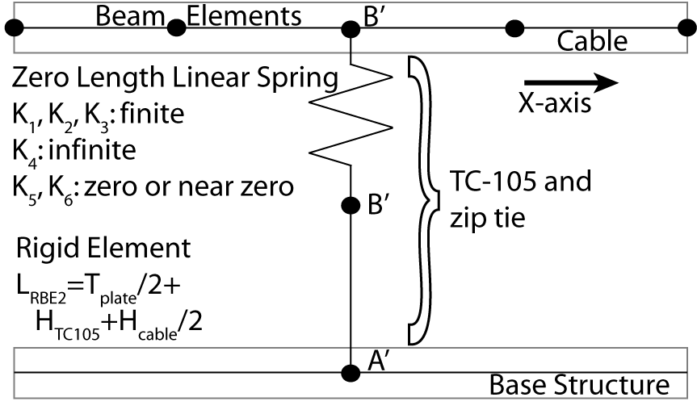
Cable Tie Down Details

